Slide 1
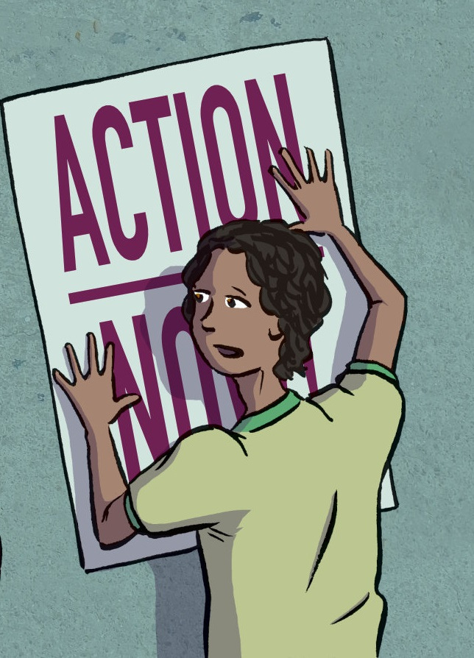


Social Action

Slide 2
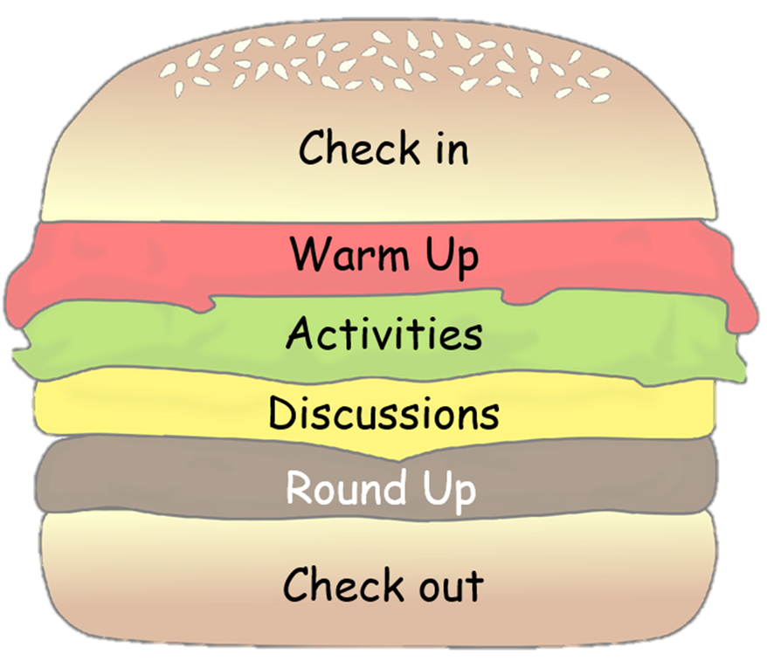
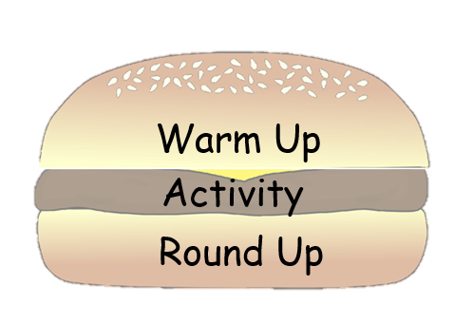
Choose your lesson toppings
These slides have been created to help you structure your Peer Education sessions. Choose elements from the sections below (you don't need them all) to build your session around your activity. Delete the slides you don't need and save your powerpoint. Remember to check the notes section for any instructions.

Slide 3
Topping Descriptions
Check in/Check Out - Allow for space and time for thoughts/feelings/learning to be shared.
Starter/Warm Up - A fun way to hook and conclude your lesson.
Activity - Where you introduce and explore your key points.
Discussion - Give your group time to talk about the topic, ideas and experiences.
Round Up - Sum up the key points of your lesson.

Slide 4

Resourse Content
  Check in
  Warm ups
  Activities
  Discussions
  Round up activities

Slide 5

Check in

Slide 6
Check in
Example Questions
Describe how your feeling using a colour
What's one thing that you saw or heard from our last session that has stuck with you?
What was the best part of the past week for you?
What’s one thing you hope to get achieve from today’s session?
Notes:
Questions should be chosen based upon time and aim of your circle. Use a talking object to help control people talking over each other.

Slide 7
Warm Up

Slide 8
The Journey to Social Action
How much do you know about Social Action?
Notes:
Time: 10 minutes
Resources:
- A ball (or something to throw)
- A list of alcoholic drinks
www.yougov.co.uk/ratings/food/popularity/alcohol-brands/all

Slide 9

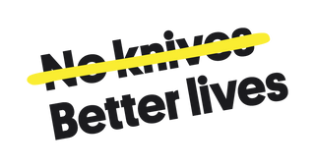
"Be the change you wish to see in the world."
Mahatma Gandhi
Notes:
Ask the students to take a few minutes to reflect on the quote and discuss it in pairs or small groups. Encourage them to share what they think the quote means and how it might relate to the concept of social action.
Class Discussion: After the small group discussions, facilitate a whole-class discussion. Ask a few groups to share their interpretations of the quote and their thoughts on how it connects to social action. Encourage students to build on each other's ideas and think critically about the importance of individual actions in creating positive social change.

Slide 10

Role models & Inspirations
Causes and Issues
Social Action
Youth Violence
What does this look like?
Benefits
Notes:
Divide the learners into groups of 3-4 and handout large sheets of paper or whiteboards and markers to each group.
Explain that they will create a mind map to explore their current understanding of social action. Instruct them to write "Social Action" in the center of the paper and draw branches coming from the center to represent different aspects or elements related to social action. (They can copy from the slide or think of their own)
Give the students around 5-7 minutes to brainstorm and discuss within their groups. Encourage them to think about the following questions:
- What does social action mean to you?
- What are some examples of social action you have seen or heard about in your community or beyond?
- Why is social action important?
After the brainstorming time is up, ask each group to present their mind maps to the rest of the class. Encourage them to explain their thought process and the different elements they included in their mind maps.
Facilitate a brief class discussion where you can summarise the common themes and ideas that emerged from the different groups' mind maps. Use this opportunity to clarify any misconceptions and reinforce the key concepts related to social action.

Slide 11
Activities

Slide 12
Peer Power
Develop your understanding of the significance of using collective voices to advocate for change. Write a letter to a person in power to highlight offensive weapon or youth violence issues within your community. What change would you like to see?
Notes:
Timing: 45 mins
Handout
Lined paper
Pens
Text/images for gallery walk (optional)
Explain that we have the power to make a change within our communities and the more voices we gather the louder we are, and the more likely we are to be heard by influential people.

Slide 13
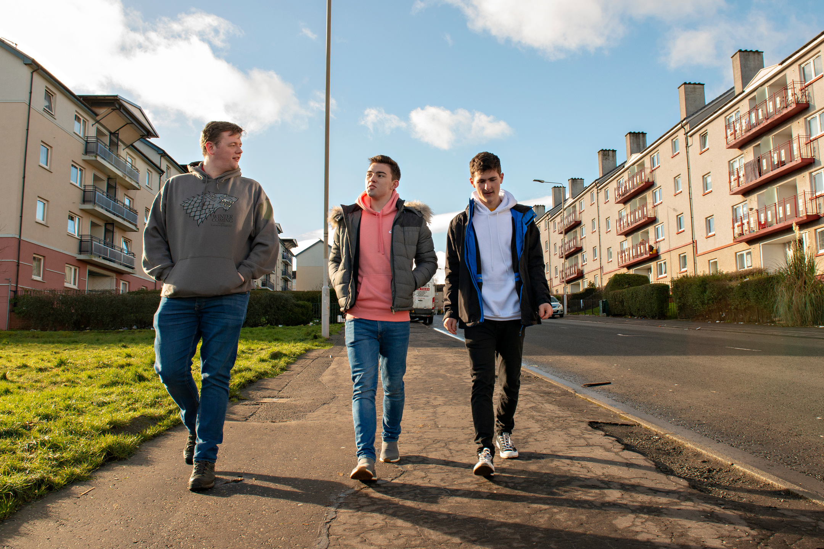
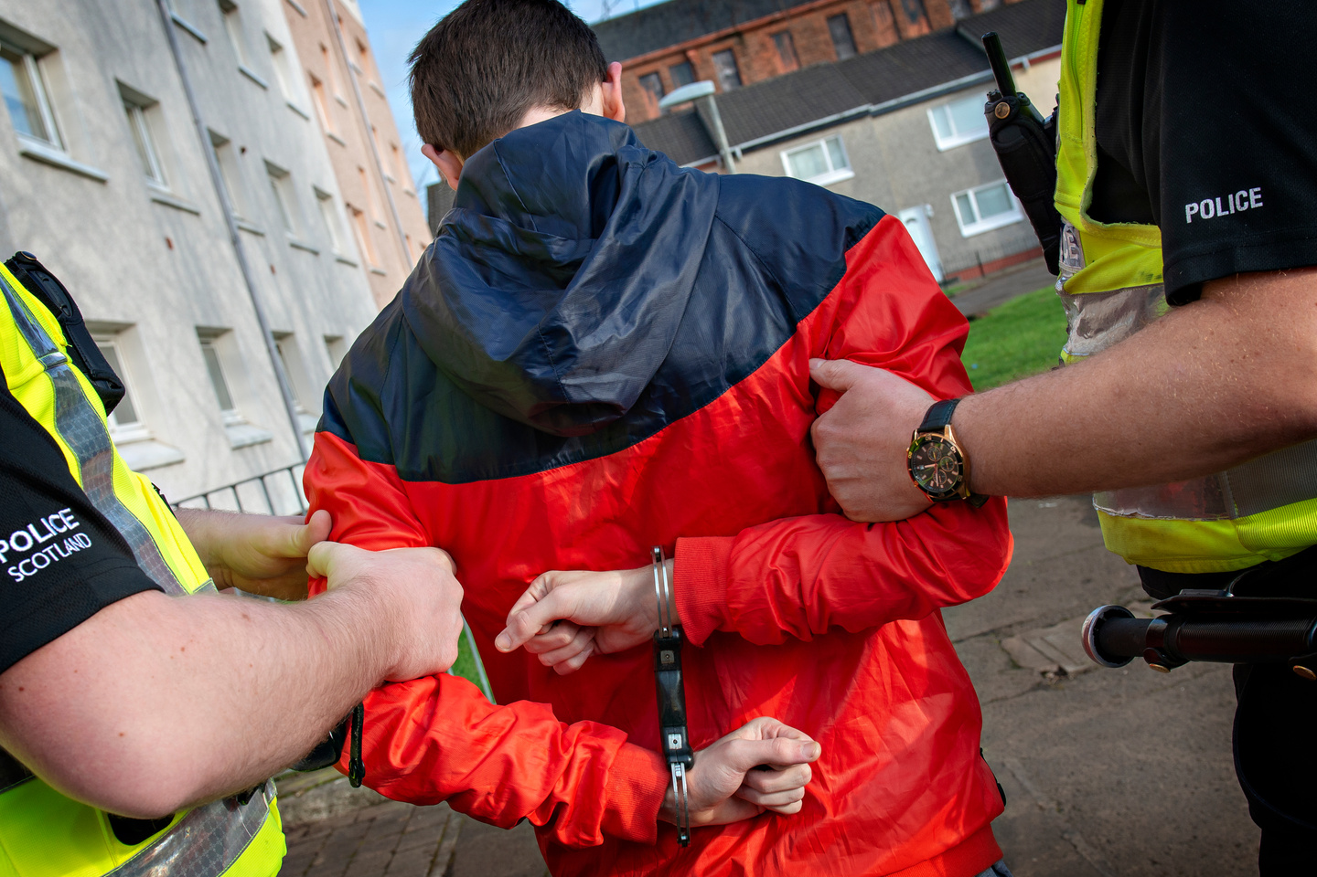
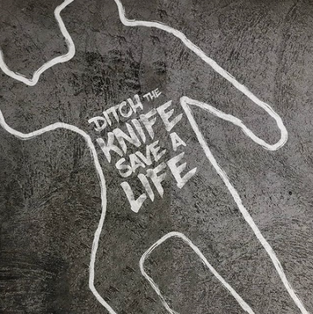
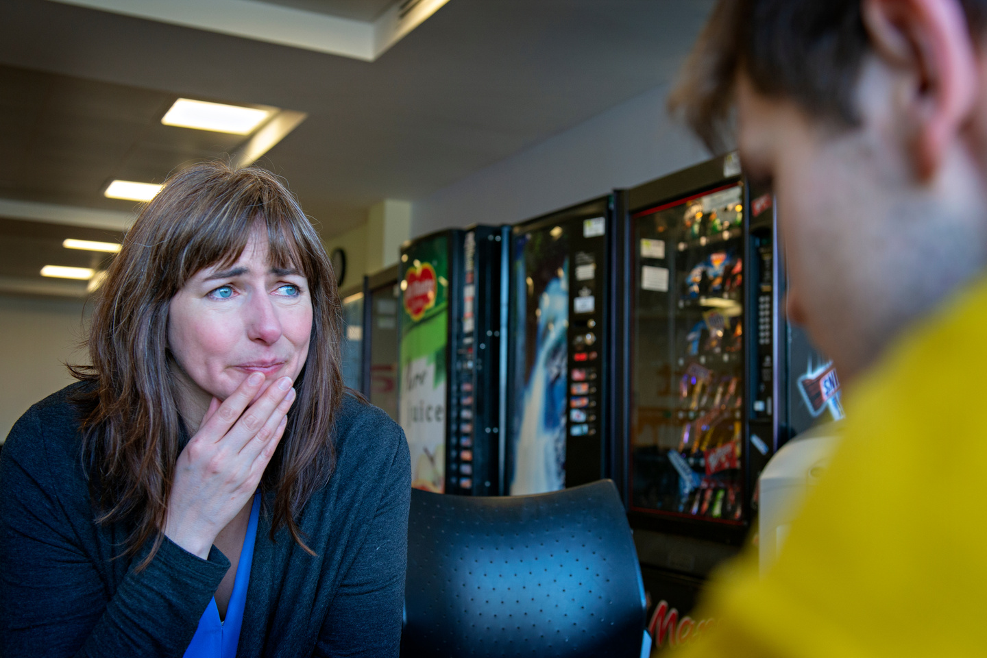
Gallery Walk
Notes:
As a group, agree on what issue you would like to raise and what action you would like to see taken to make your community safer.
To help learners come up with ideas they could go on a "gallery walk". Place images and information on knife crime and the drivers of youth violence at different stations around the room. Rotate the groups around the stations to help inspire learners with issues within the community they could focus on.
Who is the best person to write to that could make this happen? A teacher? Councillor? Police?

Slide 14
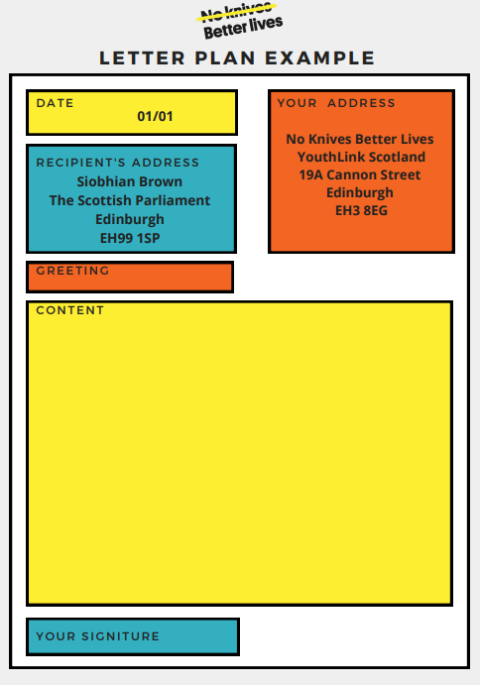
Planning Your Letter
Notes:
As a group create a plan. Use the template in the handouts to help you. Provide tips for when they’re writing and allow them to begin.
Stop them every so often and ask someone to share what they’ve written so far. Re-emphasise the influence that they have to make change both within their community and nationally.
Have your supporter look over the letters before deciding whether they are appropriate to be sent to the chosen person.

Slide 15
The Importance of Peer Power
  Stronger Together
  Big Impact
  Fresh Ideas
  Get Heard
  Feel Empowered
Using our voices together can make a world of difference, and it shows that we care about making our communities better and safer for everyone.
Notes:
Stronger Together: When we all join forces and stand up for a cause, we become a powerful team. Our message becomes way stronger, and more people pay attention to what we have to say.
Big Impact: Acting together means we can make a bigger impact. It's like having a superhero squad where each member brings their own unique skills to fight for what's right.
Fresh Ideas: When we listen to each other's stories and ideas, we come up with creative solutions. It's like mixing different colors to create an awesome new shade.
Get Heard: People in charge listen more when a whole bunch of us speak up. It's like turning up the volume on a song everyone loves.
Feel Empowered: When we work as a team, we feel stronger and more confident. It's like having a bunch of friends who always have your back.

Slide 16
Amplifying Voices
Create a podcast episode that raises awareness of youth violence or offensive weapons, encourages dialogue, and promotes positive change in their communities.
Notes:
Timing: 1 hour
A device to play and record the podcasts.
Pens/pencils.

Slide 17

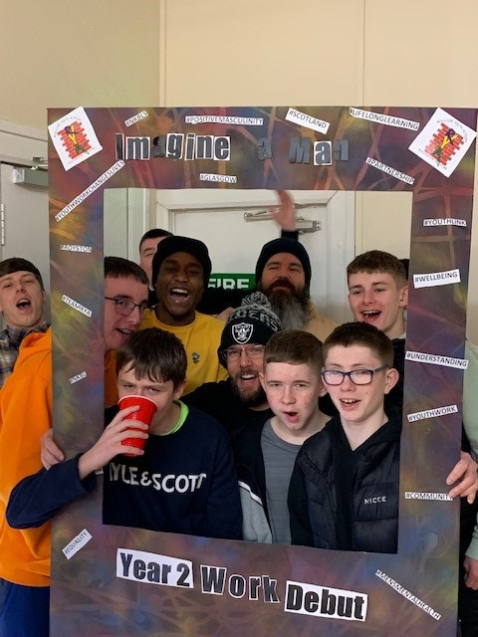
Royston Youth Action Podcast
Notes:
Introduce the session by playing the Imagine a Man podcast by Royston Youth Action. Explain the importance of addressing youth violence and the power of podcasting as a medium for sharing stories and generating meaningful conversations. Discuss what they have been learned about youth violence, its impact on individuals, families and communities.

Slide 18

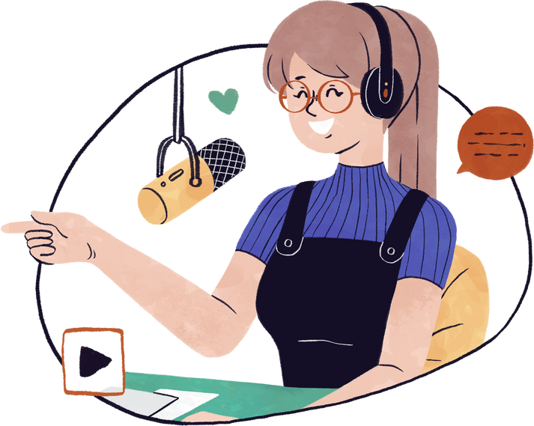
What is the goal of your podcast?
Promote dialogue.
Raise the awareness of an issue.
Inspire others to take positive action.
Notes:
Explain that they are going to be creating their own podcast and split them into teams. If not already set by you, help them define the goals of their podcast episode, such as raising awareness, inspiring action, or promoting dialogue.
Discuss the importance of identifying a target audience to tailor their message effectively. Give out the handout and go over the components of a podcast episode: introduction, main content, personal stories, facts/statistics and a conclusion.
Brainstorm ideas and guide the groups in structuring their episode. Encourage them to think about engaging hooks, compelling narratives, and key messages. Encourage them to use the template to organise their thoughts and creating an outline for their episode.

Slide 19
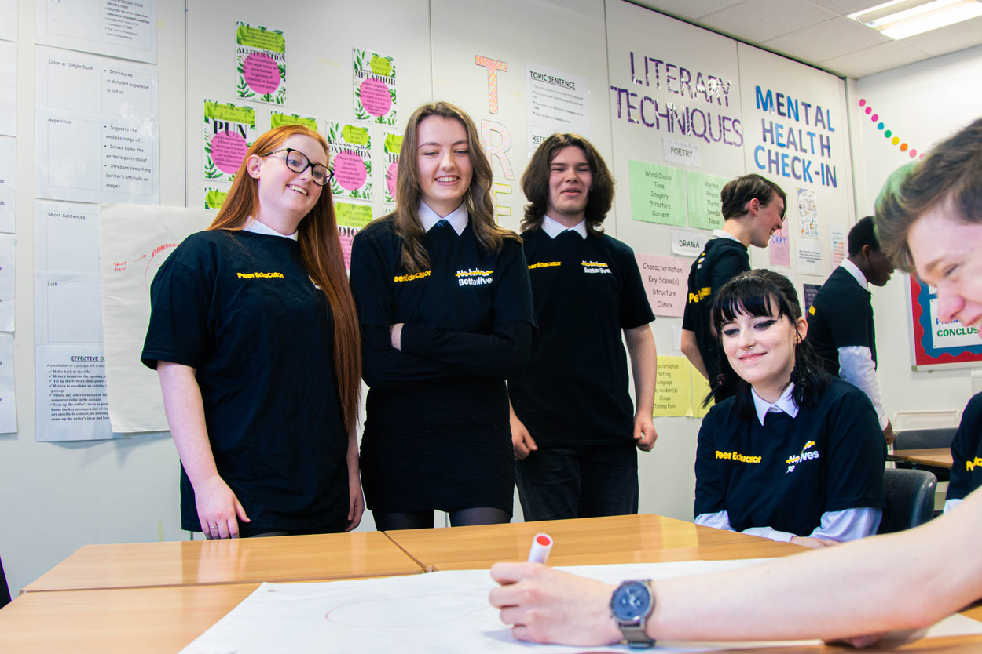

Finished? Create a name and logo for your podcast
Podcast for teens, by teens.
Notes:
As a fast finisher task, ask the group to design an image and name for their podcast episode. They could also explore potential platforms for hosting and sharing the podcast episode, such as SoundCloud or Anchor. Encourage participants to develop a plan for promoting their podcast episode to reach a wider audience.
Recap the key points covered in the lesson. Ask the groups to reflect on their experience and share any insights or challenges they encountered.

Slide 20
Awareness to Action
Use your knowledge to create a poster that influences your peers to make more positive choices when faced with risk taking behaviours.
Notes:
Timing: 45 mins
Large piece of paper for each learner/group
Access to NKBL resources for research (optional)
Pens, coloured pencils or art supplies
Scissors, glue and other necessary supplies
Poster examples

Slide 21
Risk taking behaviours: Why is it important to make positive choices when faced with challenges?
  What are some common risk-taking behaviors that young people may encounter?
  How can making positive choices in challenging situations impact our overall well-being and future opportunities?
  What are some strategies we can use to resist negative peer pressure and make positive decisions?
  How does making positive choices contribute to building a responsible and respectful community?
  Can you think of any real-life examples where making a positive choice in a risky situation led to a better outcome?
Notes:
Discuss the importance of making positive choices when faced with risk-taking behaviours. Explain that learners will be creating a poster to present facts and promote positive alternatives to risk-taking behaviours. Emphasise the impact of visual communication and the ability of a poster to capture attention and convey messages effectively.

Slide 22
Alternative
Choices
Notes:
On a whiteboard or flipchart paper, facilitate a brainstorming session to create a list of alternative choices when faced with risk-taking situations. Encourage students to think creatively and consider options that promote personal well-being, a bystander approach and positive social action. Learners can then use these ideas to inspire their poster design.
Explain that you are looking for their poster to meet the following criteria:
a clear message
eye catching
don't have weapons, blood or scare tactics.

Slide 23

Poster Time!
Remember we are looking for posters that...
  have a clear message
  are eye catching
  don't have weapons, blood or scare tactics.
Notes:
Allow time for the learners to share their posters with the class (this can be during and/or at the end). Encourage them to explain the message behind their design and the positive choices they want to promote. Others can provide feedback and share their thoughts on the effectiveness of the message.
Lead a reflective discussion about the process of creating the posters and the influence they can have on spreading information and promoting positive choices. Why is this important? Encourage learners to consider ways they can use their posters in their community or school to create social change.

Slide 24
Empowering Choices
Help raise awareness amongst your peers about the consequences of risk-taking behaviors, specifically focusing on the topic of knife crime. Using the NKBL website, create a presentation allowing your peers make more positive, informed decisions.
Notes:
Timing: 1 hour
A computer/laptop with internet access
Presentation software e.g. PowerPoint, Google Slides
Paper for notes

Slide 25
Last Person Standing
Write 'Risk-taking Behaviours' on your piece of paper . You have two minutes to write down as many things you can remember about risk taking behaviours as possible.
Notes:
Put the young people into small groups and ask them to write "Risk-taking Behaviours" in the centre of a blank piece of paper. Put a 2 minute timer on the board and ask them to write down what they can remember about these behaviours from previous sessions or their own knowledge. Play last person standing: go around the room getting a different answer from each group. If they run out of answers or repeat another groups answer, they need to sit down. The last group standing wins.
Explain that they are going to be using the NKBL website to create a presentation to influence their peers to take informed action against knife crime.

Slide 26
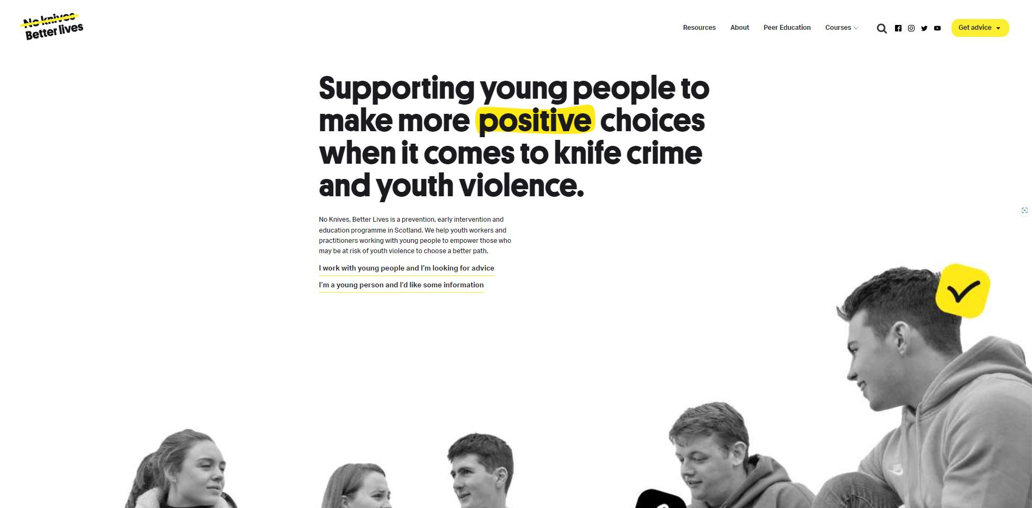
No Knives Better Lives Website
Notes:
Provide a brief overview of www.noknivesbetterlives.com. Discuss the potential consequences and dangers associated with knife crime, such as violence, injury, legal consequences, and the impact on families and communities (Use the peer ed module to help you). Encourage them to think critically about why individuals may engage in risk-taking behaviours and the factors that influence their decisions.
Throughout the session emphasise the importance of maintaining a respectful and empathetic when discussing sensitive topics such as knife crime. Remind learners that the goal is to educate and raise awareness rather than pass judgment or stereotype individuals involved in risk-taking behaviours.

Slide 27
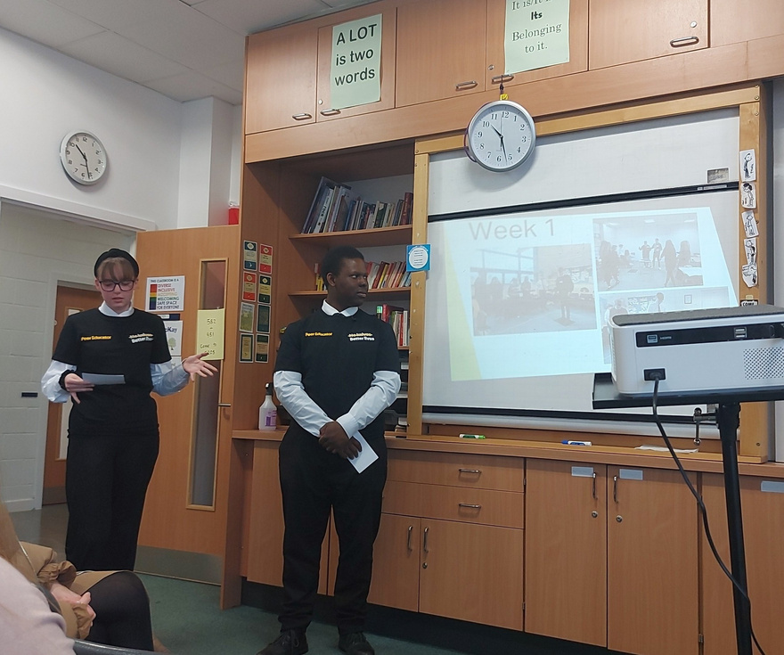
Creating Your Presentation
Aim: To create a presentation that educates and engages your peers, highlighting the risks and consequences of knife crime and promoting positive choices.
Rememeber:
  Include visual aids such as images and videos.
  Are there any relevant real-life examples you could include?
  Avoid images of blood, knives or use of scare tactics.
Notes:
In pairs, give the learners time to explore the NKBL website. Encourage them to take notes on key information they find interesting or impactful including statistics, case studies and personal stories.
Join two sets of pairs together to form a group of 4 and explain that they are to create a presentation using the information that both sets of pairs gathered. Emphasise that the presentation should aim to educate and engage their peers, highlighting the risks and consequences of knife crime and promoting positive choices. Encourage creativity in the presentation design by including visual aids, images, videos, and real-life examples. Remind students that there should be no images of blood, knives or use of scare tactics.
At the end, encourage students to reflect on their own attitudes towards risk-taking behaviours and the impact the information they learned might have on their decision-making. Discuss the importance of spreading awareness amongst peers and taking responsibility for promoting positive choices.

Slide 28
Create a Ripple Effect
A collection of 'small' actions within your community can create a rippling effect, causing a national impact. This session explores the actions that can be taken personally, within your community and at a national level and who can support you in these.
Notes:
Timing: 45 mins
A screen and PC or device to play the video.
Small stone and tub of water.
Post-it notes.
Pens/Pencils.
Throw a stone into a tub of water (or similar). Watch how the water around it changes, much further away than where the stone entered the water. This is proof that a small action can lead to bigger changes, even if you can't see how far it will reach. This is the rippling effect. Play the video explaining local to global impact. Discuss the current situation of youth violence within your community.

Slide 29

Create a Ripple Effect
Personal
Local
National
Collect the actions you feel could be done at your allocated level.
Notes:
Split the group into three teams and allocate them one of the following levels: personal, local, national. The team should safely move around the room and collect the cards they feel could be done at each level to have a larger impact. There may be more than one of the same card. Discuss what actions each team chose for their level and why. Would they add any actions to the cards?

Slide 30
Create a Ripple Effect
Personal
Local
National
Notes:
The group have identified what they could do individually, locally andas a country to have a impact on reducing youth violence nationally. Ask them to consider what actions they could realistically take to start or contribute to a rippling effect personally and within their community. What support do they need to accomplish this? Have them write this on a post-it note or piece of paper.
Summarise the session emphasising that small actions can make big differences within their community and beyond.

Slide 31
Signature Collection
Get people on board with your cause by gathering signatures.
Notes:
Timing: 30 mins
A screen and PC or device to show powerpoint
Pencils

Slide 32
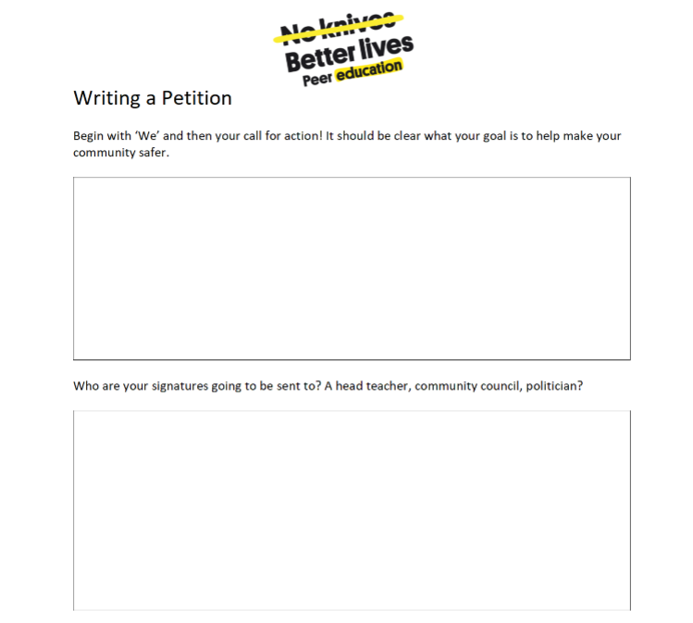
Creating your petition
Notes:
Create a list of how they will collect signatures, who will they send it to, where will they collect signatures from. Will it be online or a physical copy?
Allow them to create their own petitions and remind them to include the importance of their petition. With your peer educator supporter's consent, action the young people's plans on collecting signatures.

Slide 33
The United Nations Convention on the Rights of the Child (UNCRC)
Notes:
Timing: 20 mins
A copy of the UNCRC
Identify one side of the room as agree and the other as disagree. For each statement the young people should place themselves somewhere along the scale. Discuss their decisions as you go along.

Slide 34
Agree or Disagree
Human rights are only necessary for people who live in countries where there is a lot of poverty or war.

Slide 35
Agree or Disagree
Children have their own human rights treaty because childhood is a very precious time.

Slide 36
Agree or Disagree
Ordinary people can do much more than the Government to protect human rights.

Slide 37
Agree or Disagree
You have to be a certain age to have the right to be heard and taken seriously.

Slide 38
Agree or Disagree
If children commit crimes, their rights should be removed.

Slide 39
Agree or Disagree
Children have their own human rights treaty because there are things that children need that adults don’t.

Slide 40
Agree or Disagree
Picking on someone is a violation of their human rights.

Slide 41
Agree or Disagree
Babies have human rights.

Slide 42
Agree or Disagree
Babies have human rights.

Slide 43
In pairs, look at the UNCRC handout and discuss the following:
  Do any of the rights surprise you?
  Can you think of any rights that have not been included?
  Whose responsibility is it to ensure these are being upheld?
  Why is it import to protect and advocate for these rights?
Notes:
1...
Do any of the rights surprise you?
2...
Can you think of any rights that have not been included?
3...
Whose responsibility is it to ensure these are being upheld?
4...
Why is it import to protect and advocate for these rights?

Slide 44
Discussions

Slide 45
Positive Social Action
Discuss what positive social action means to you and what this might look like within your community.
Notes:
Timing: 15mins

Slide 46
1... What does positive social action mean to you?
2... Why do you think it's important for young people to engage in positive social action?
3... What are some social issues or challenges in our community that you would like to address through positive social action?
4... How can we inspire and motivate others to get involved in positive social action?
5... What are some practical steps we can take to initiate positive social action in our community?

Slide 47
The Importance of Youthwork
Discuss the impact of youthwork on you and the community.
Notes:
Timing: 15mins

Slide 48
1... What youthwork is available within your community?
2... Does anyone attend any of these? What effect have they had on you?
3... What role do you think youthwork can play in reducing youth violence?
4...What do you think will be the consequences of funding being cut for youthwork services.
5...Are there any barriers to you accessing youthwork?

Slide 49
Round Up

Slide 50
Check out
Example Questions
What are two things you learned?
What is the most interesting thing you’ve learned?
Think of one thing you have learned in the session that you can apply to another part of your life. What is it, and how can you apply it?
What was your favorite activity in the session? Why?
What was your least favorite activity in session? Why?
What would you tell your parents or guardians you did in this session?
How does something you learned connect to what you already knew?
How did it extend your thinking further?
What questions do you still have?
Notes:
Questions should be chosen based upon time and aim of your circle. Use a talking object to help control people talking over each other.

