Slide 1
Primary School
Programme

Slide 2
Choose your lesson toppings
These slides have been created to help you structure your Peer Education sessions. Choose elements from the sections below (you don't need them all) to build your session around your activity. Delete the slides you don't need and save your powerpoint. Remember to check the notes section for any instructions.

Slide 3
Topping Descriptions
Check in/Check Out - Allow for space and time for thoughts/feelings/learning to be shared.
Starter/Warm Up - A fun way to hook and conclude your lesson.
Activity - Where you introduce and explore your key points.
Discussion - Give your group time to talk about the topic, ideas and experiences.
Round Up - Sum up the key points of your lesson.

Slide 4
Resourse Content
Check in
Warm ups
Activities
Discussions
Round up activities

Slide 5
Check in

Slide 6
Check in
Example Questions
Describe how your feeling using a colour
What's one thing that you saw or heard from our last session that has stuck with you?
What was the best part of the past week for you?
What’s one thing you hope to get achieve from today’s session?
Notes:
Questions should be chosen based upon time and aim of your circle. Use a talking object to help control people talking over each other.

Slide 7
Weekly Programme

Slide 8
Week 1 - Violence in Scotland
Notes:
Timing: 45 mins
Handout
Lined paper
Pens
Text/images for gallery walk (optional)
Explain that we have the power to make a change within our communities and the more voices we gather the louder we are, and the more likely we are to be heard by influential people.

Slide 9
Notes:
As a group create a plan. Use the template in the handouts to help you. Provide tips for when they’re writing and allow them to begin.
Stop them every so often and ask someone to share what they’ve written so far. Re-emphasise the influence that they have to make change both within their community and nationally.
Have your supporter look over the letters before deciding whether they are appropriate to be sent to the chosen person.

Slide 10
Notes:
As a group create a plan. Use the template in the handouts to help you. Provide tips for when they’re writing and allow them to begin.
Stop them every so often and ask someone to share what they’ve written so far. Re-emphasise the influence that they have to make change both within their community and nationally.
Have your supporter look over the letters before deciding whether they are appropriate to be sent to the chosen person.

Slide 11
The Ripple Effect
Personal
School
Community
Notes:
The group have identified what they could do individually, locally andas a country to have a impact on reducing youth violence nationally. Ask them to consider what actions they could realistically take to start or contribute to a rippling effect personally and within their community. What support do they need to accomplish this? Have them write this on a post-it note or piece of paper.
Summarise the session emphasising that small actions can make big differences within their community and beyond.

Slide 12
Week 2 - Knife Facts and The Bystander Effect
Notes:
Timing: 1 hour
A device to play and record the podcasts.
Pens/pencils.

Slide 13
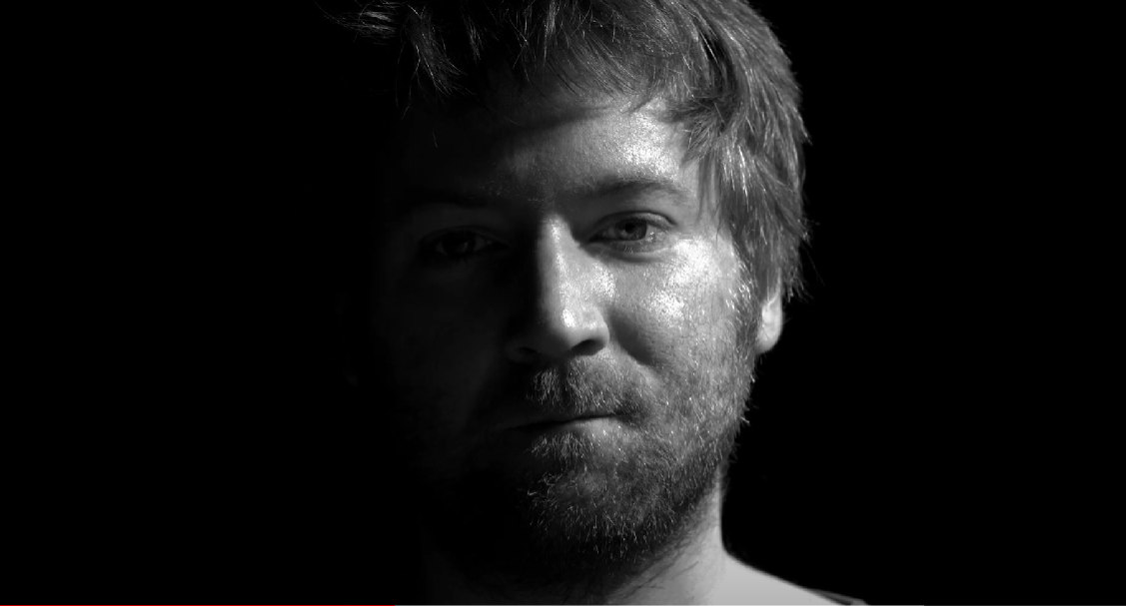
Don’t Be in the Dark About Knife Crime
Notes:
Introduce the topic by explaining that we are going to watch a series of videos that ask us how well we know the facts on knife crime and the law.
You can have different voting areas in the room that people move to or you can do a show of hands. Each video lasts around 1 minute.

Slide 14
What happens if you're caught with a knife?
Notes:
Introduce the topic by explaining that we are going to watch a series of videos that ask us how well we know the facts on knife crime and the law.
You can have different voting areas in the room that people move to or you can do a show of hands. Each video lasts around 1 minute.

Slide 15
What happens if you're caught with a knife?
Notes:
Introduce the topic by explaining that we are going to watch a series of videos that ask us how well we know the facts on knife crime and the law.
You can have different voting areas in the room that people move to or you can do a show of hands. Each video lasts around 1 minute.

Slide 16
What are the consequences of carrying a knife?
Notes:
Introduce the topic by explaining that we are going to watch a series of videos that ask us how well we know the facts on knife crime and the law.
You can have different voting areas in the room that people move to or you can do a show of hands. Each video lasts around 1 minute.

Slide 17
What happens if you use a knife on someone?
Notes:
Ask the group if they were surprised by any of the facts. Reinforce that it's important to know about the facts, your rights and the law because you never know when you'll be in the wrong place at the wrong time.
It's making the right decisions that are important. They've made the right choice just to be part of this group and take part in this activity.

Slide 18
Week 3 - Alcohol
Notes:
Timing: 45 mins
Handout
Lined paper
Pens
Text/images for gallery walk (optional)
Explain that we have the power to make a change within our communities and the more voices we gather the louder we are, and the more likely we are to be heard by influential people.

Slide 19
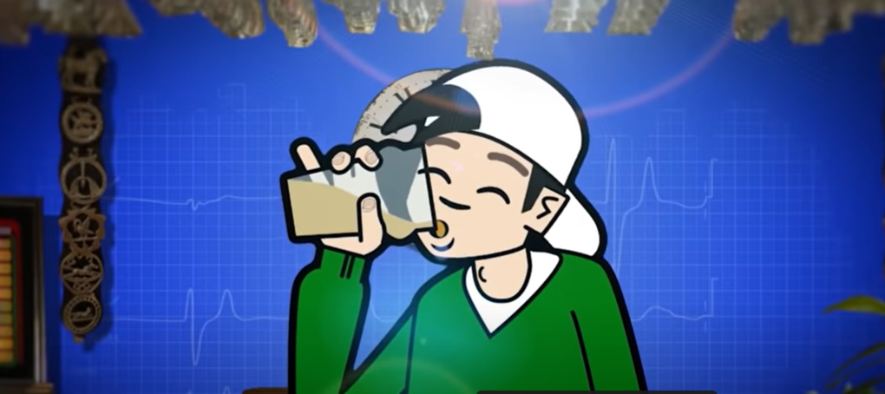
Effect of Alcohol on the Body
Notes:
Start by watching the video of a house party then discuss the questions on the next slide.

Slide 20
Week 4 – First Aid/Knife Facts
Notes:
Timing: 45 mins
Handout
Lined paper
Pens
Text/images for gallery walk (optional)
Explain that we have the power to make a change within our communities and the more voices we gather the louder we are, and the more likely we are to be heard by influential people.

Slide 21
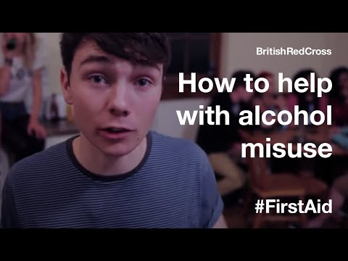
First Aid Video - Part 1
Notes:
Start by watching the video of a house party then discuss the questions on the next slide.

Slide 22
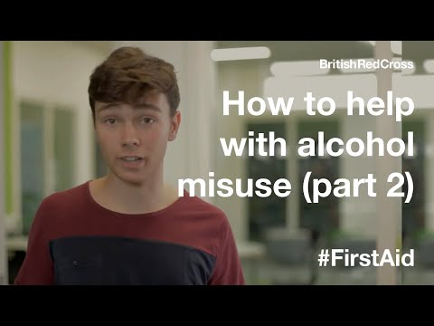
First Aid Video - Part 2
Notes:
Explain that you are going to learn about the 'pushover' or recovery position. Split the group into pairs and follow the video instructions in the link, as follows:
Watch the demonstration of the ‘pushover’
Pause the film : ask the pairs to move to a position in the room with clear space around them.
Play the next extract where Mark explains that the first step is to get one person to lie on their back.
Pause the film : one member of each pair should now lie on their back.
Next Mark instructs the person doing the ‘pushover’ to check their partner’s breathing.
Pause the film : check breathing by tilting their head back and looking and feeling for breaths.
Mark explains that the next step is to push their partner onto their side and tilt their head back.
Pause the film : push them on to their side and tilt their head back.
Mark says to check breathing once again and then call 999.
Pause the film : check they are still breathing. Pretend to Call 999.
Mark explains that it’s now time to swap over so the other person in the pair can have a go.
Pairs should swap over and repeat the exercise.
Play to the end, a final reminder of the ‘pushover’ is given.
Talk about how group members now feel about the video and using the pushover recovery technique.

Slide 23
Week 5 – Positive Masculinity
Notes:
Timing: 45 mins
Handout
Lined paper
Pens
Text/images for gallery walk (optional)
Explain that we have the power to make a change within our communities and the more voices we gather the louder we are, and the more likely we are to be heard by influential people.

Slide 24
Royston Youth Action Podcast
Notes:
Introduce the session by playing the Imagine a Man podcast by Royston Youth Action. Explain the importance of addressing youth violence and the power of podcasting as a medium for sharing stories and generating meaningful conversations. Discuss what they have been learned about youth violence, its impact on individuals, families and communities.

Slide 25
Week 6 – Mental Wellbeing
Notes:
Timing: 45 mins
Handout
Lined paper
Pens
Text/images for gallery walk (optional)
Explain that we have the power to make a change within our communities and the more voices we gather the louder we are, and the more likely we are to be heard by influential people.

Slide 27
Week 7 and 8 – Social Action
Notes:
Timing: 45 mins
Handout
Lined paper
Pens
Text/images for gallery walk (optional)
Explain that we have the power to make a change within our communities and the more voices we gather the louder we are, and the more likely we are to be heard by influential people.

Slide 28
Podcast
Notes:
Timing: 45 mins
Handout
Lined paper
Pens
Text/images for gallery walk (optional)
Explain that we have the power to make a change within our communities and the more voices we gather the louder we are, and the more likely we are to be heard by influential people.

Slide 29
Royston Youth Action Podcast
Notes:
Introduce the session by playing the Imagine a Man podcast by Royston Youth Action. Explain the importance of addressing youth violence and the power of podcasting as a medium for sharing stories and generating meaningful conversations. Discuss what they have been learned about youth violence, its impact on individuals, families and communities.

Slide 30
What is the goal of your podcast?
Promote dialogue.
Raise the awareness of an issue.
Inspire others to take positive action.
Notes:
Explain that they are going to be creating their own podcast and split them into teams. If not already set by you, help them define the goals of their podcast episode, such as raising awareness, inspiring action, or promoting dialogue.
Discuss the importance of identifying a target audience to tailor their message effectively. Give out the handout and go over the components of a podcast episode: introduction, main content, personal stories, facts/statistics and a conclusion.
Brainstorm ideas and guide the groups in structuring their episode. Encourage them to think about engaging hooks, compelling narratives, and key messages. Encourage them to use the template to organise their thoughts and creating an outline for their episode.

Slide 31
Finished? Create a name and logo for your podcast
Podcast for teens, by teens.
Notes:
As a fast finisher task, ask the group to design an image and name for their podcast episode. They could also explore potential platforms for hosting and sharing the podcast episode, such as SoundCloud or Anchor. Encourage participants to develop a plan for promoting their podcast episode to reach a wider audience.
Recap the key points covered in the lesson. Ask the groups to reflect on their experience and share any insights or challenges they encountered.

Slide 32
Awareness to Action
Use your knowledge to create a poster that influences your peers to make more positive choices when faced with risk taking behaviours.
Notes:
Timing: 45 mins
Large piece of paper for each learner/group
Access to NKBL resources for research (optional)
Pens, coloured pencils or art supplies
Scissors, glue and other necessary supplies
Poster examples

Slide 33
Poster Time!
Remember we are looking for posters that...
have a clear message
are eye catching
don't have weapons, blood or scare tactics.
Notes:
Allow time for the learners to share their posters with the class (this can be during and/or at the end). Encourage them to explain the message behind their design and the positive choices they want to promote. Others can provide feedback and share their thoughts on the effectiveness of the message.
Lead a reflective discussion about the process of creating the posters and the influence they can have on spreading information and promoting positive choices. Why is this important? Encourage learners to consider ways they can use their posters in their community or school to create social change.

Slide 34
Empowering Choices
Help raise awareness amongst your peers about the consequences of risk-taking behaviors, specifically focusing on the topic of knife crime. Using the NKBL website, create a presentation allowing your peers make more positive, informed decisions.
Notes:
Timing: 1 hour
A computer/laptop with internet access
Presentation software e.g. PowerPoint, Google Slides
Paper for notes

Slide 35
No Knives Better Lives Website
Notes:
Provide a brief overview of www.noknivesbetterlives.com. Discuss the potential consequences and dangers associated with knife crime, such as violence, injury, legal consequences, and the impact on families and communities (Use the peer ed module to help you). Encourage them to think critically about why individuals may engage in risk-taking behaviours and the factors that influence their decisions.
Throughout the session emphasise the importance of maintaining a respectful and empathetic when discussing sensitive topics such as knife crime. Remind learners that the goal is to educate and raise awareness rather than pass judgment or stereotype individuals involved in risk-taking behaviours.

Slide 36
Creating Your Presentation
Aim: To create a presentation that educates and engages your peers, highlighting the risks and consequences of knife crime and promoting positive choices.
Rememeber:
Include visual aids such as images and videos.
Are there any relevant real-life examples you could include?
Avoid images of blood, knives or use of scare tactics.
Notes:
In pairs, give the learners time to explore the NKBL website. Encourage them to take notes on key information they find interesting or impactful including statistics, case studies and personal stories.
Join two sets of pairs together to form a group of 4 and explain that they are to create a presentation using the information that both sets of pairs gathered. Emphasise that the presentation should aim to educate and engage their peers, highlighting the risks and consequences of knife crime and promoting positive choices. Encourage creativity in the presentation design by including visual aids, images, videos, and real-life examples. Remind students that there should be no images of blood, knives or use of scare tactics.
At the end, encourage students to reflect on their own attitudes towards risk-taking behaviours and the impact the information they learned might have on their decision-making. Discuss the importance of spreading awareness amongst peers and taking responsibility for promoting positive choices.

Slide 37
Signature Collection
Get people on board with your cause by gathering signatures.
Notes:
Timing: 30 mins
A screen and PC or device to show powerpoint
Pencils

Slide 38
Creating your petition
Notes:
Create a list of how they will collect signatures, who will they send it to, where will they collect signatures from. Will it be online or a physical copy?
Allow them to create their own petitions and remind them to include the importance of their petition. With your peer educator supporter's consent, action the young people's plans on collecting signatures.

