Slide 1
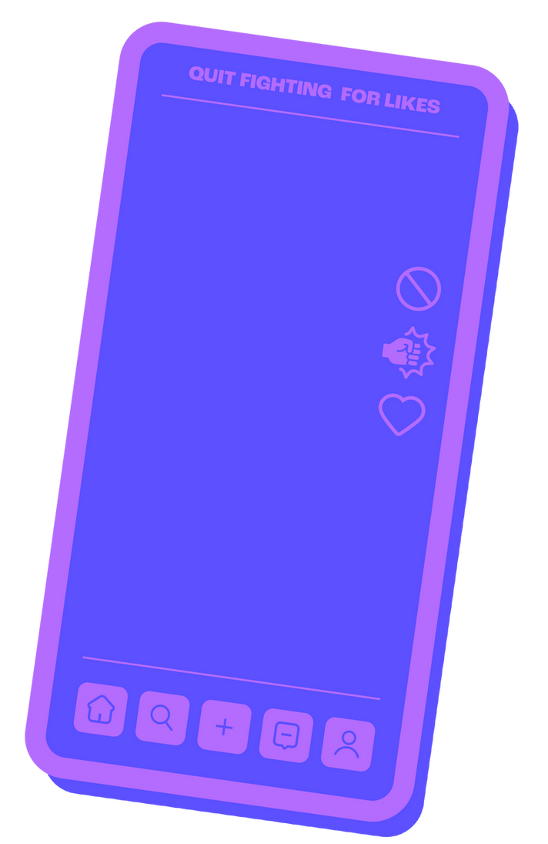




SOCIAL MEDIA
PEER EDUCATION MODULE
Funded By

Slide 2

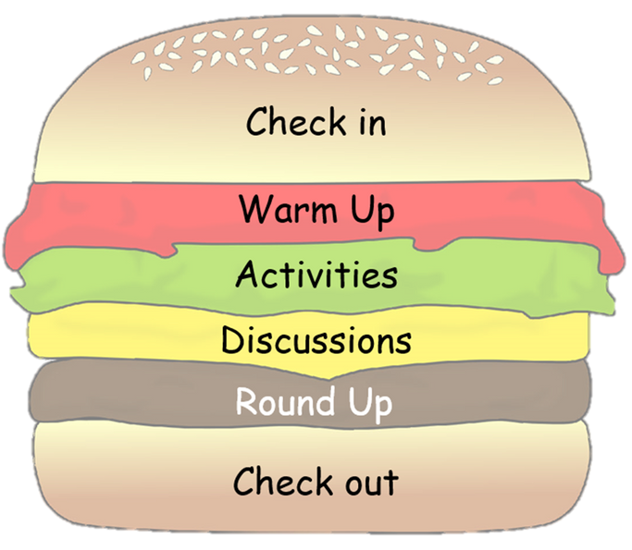
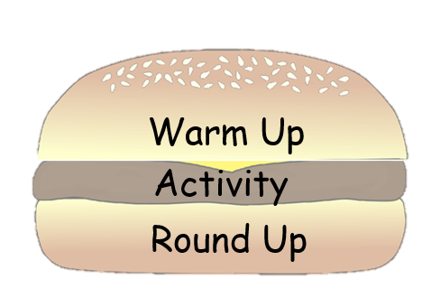
PEER EDUCATION
Choose your lesson toppings
These slides have been created to help you structure your peer education sessions. Choose elements from the sections below (you don't need them all) to build your session around your activity. Delete the slides you don't need and save your powerpoint. Remember to check the notes section for any instructions.

Slide 3
PEER EDUCATION
Topping Description:
Check in/Check Out - Allow for space and time for thoughts/feelings/learning to be shared.
Starter/Warm Up - A fun way to hook young people into your lesson.
Activity - Where you introduce and explore your key points.
Discussion - Give your group time to talk about the topic, ideas and experiences.
Round Up - Sum up the key points of your lesson.

Slide 4
PEER EDUCATION
Contents
  Check in
  Activities
  Discussions
  Check out

Slide 5
Check
In

Slide 6
PEER EDUCATION
Check In:
Example Questions:
  Describe how your feeling using a colour
  What's one thing that you saw or heard from our last session that has stuck with you?
  What was the best part of the past week for you?
  What’s one thing you hope to get achieve from today’s session?
  If your current mood were weather, what would it be?
  What’s one thing you’ve done recently that made you feel proud?

Slide 7
Activity

Slide 8
A Balanced
Feed

Slide 9
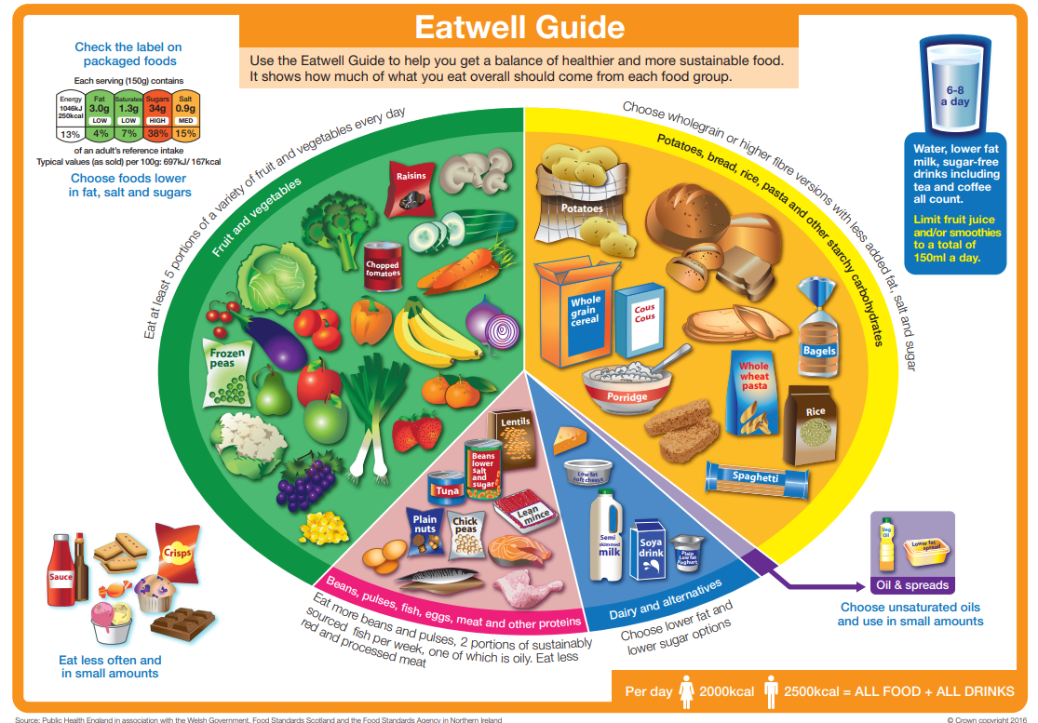
PEER EDUCATION

Slide 10
PEER EDUCATION
Social Media Diet
Fruits and Vegetables: Educational and inspirational content
Carbohydrates: Meaningful interactions and relationships
Proteins: Entertainment and hobbies
Dairy and Alternatives: Self-care and mindfulness content
Oil and Spreads: Mindless scrolling and excessive consumption

Slide 11
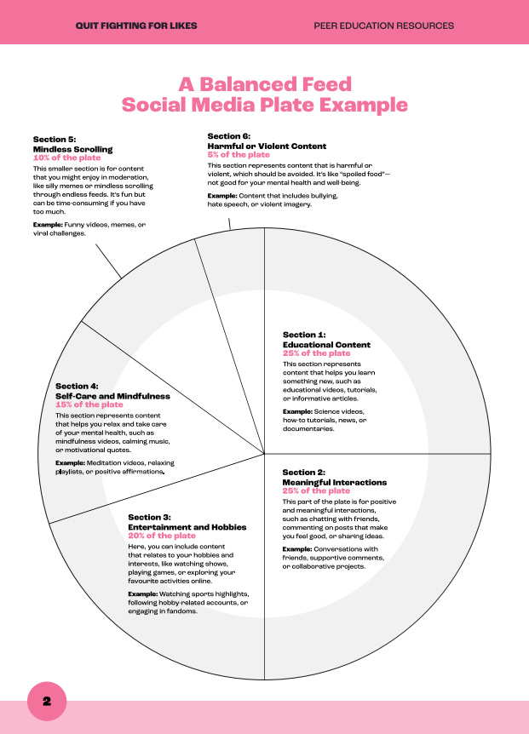
PEER EDUCATION
Example
Plate

Slide 12
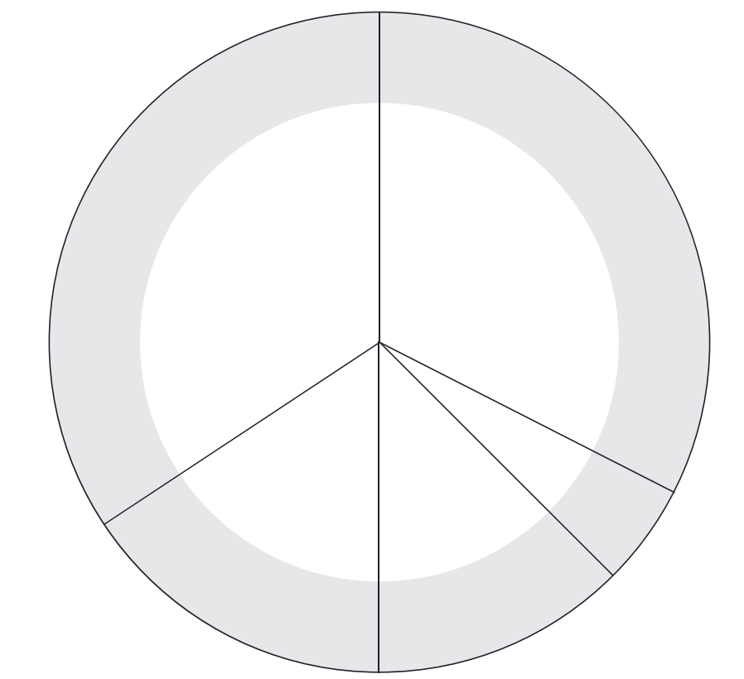
PEER EDUCATION
A Healthy Social Media Plate

Slide 13
Moral Choices Online

Slide 14
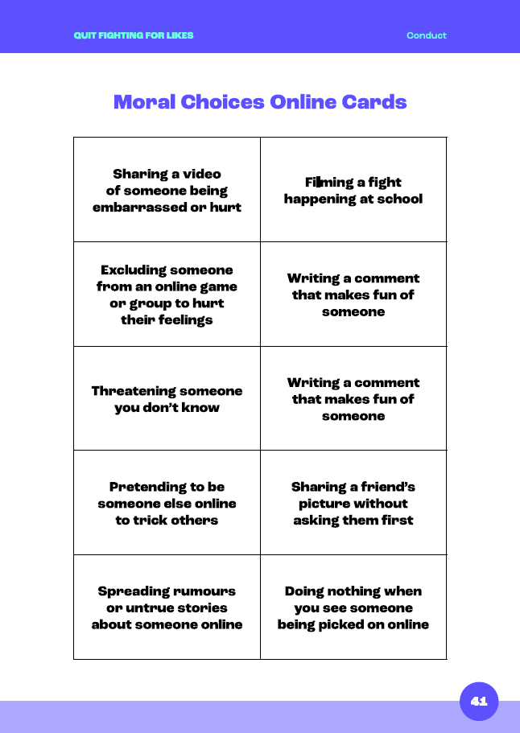
PEER EDUCATION
Rank the activities in order of seriousness
with
1 being the most wrong
and
10 being the least wrong

Slide 15
The Online Ripple Effect

Slide 16
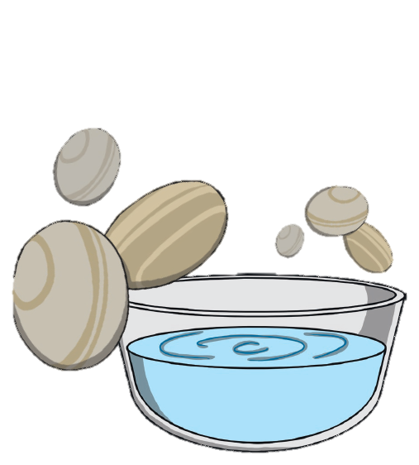
PEER EDUCATION
The Online Ripple Effect
Actions, no matter how small, can have a wider impact.
With harmful behaviours online, it isn’t just the victim's life that is impacted.
Who else?

Slide 17
PEER EDUCATION
The Online Ripple Effect
Discuss the following questions using your scenario:
  What immediate effect does this action have on the victim?
  What are the possible ripple effects on the victim’s friends, family and school?
  How could the situation have been handled differently to avoid harm.

Slide 18
PEER EDUCATION
The Online Ripple Effect
Community
In your groups complete the diagram to
show who and how different people
could be impacted by your
scenario.
Friends
Family
Person in conflict with the law
Victim

Slide 19
The Hook

Slide 20




PEER EDUCATION
Algorithms
Algorithms are tools that decide what content to show you based on what you’ve interacted with before.

Slide 21
PEER EDUCATION
How the Tik Tok Algorithm Works
Watch HERE

Slide 22
PEER EDUCATION
The Hook Scenarios
  A young person watches lots of prank and small fight videos. What will TikTok show them next?
  A young person interacts with debates and arguments that become more heated. What might TikTok suggest?
  A young person watches one video about a violent news event. How will this affect their feed?

Slide 23
Rolling Through Reactions

Slide 24
PEER EDUCATION
Roll each of the four cubes and put them together to create a full scenario then discuss the questions:
  What are the risks/impacts of the behaviour in the scenario (e.g., on mental health, yourself, and others)?
  Why might someone post this content? What are the implications of them sharing it, for them, for you, and for the person in the image or video?
  What are the possible consequences of harmful behaviour online, and how can we manage our emotions to prevent escalation?
  What could they do differently to reduce harm?
  How do your emotions and feelings influence actions?

Slide 25
Safe Spaces

Slide 26
PEER EDUCATION
Safe Spaces
What are some examples of safe spaces online, and in person?

Slide 27
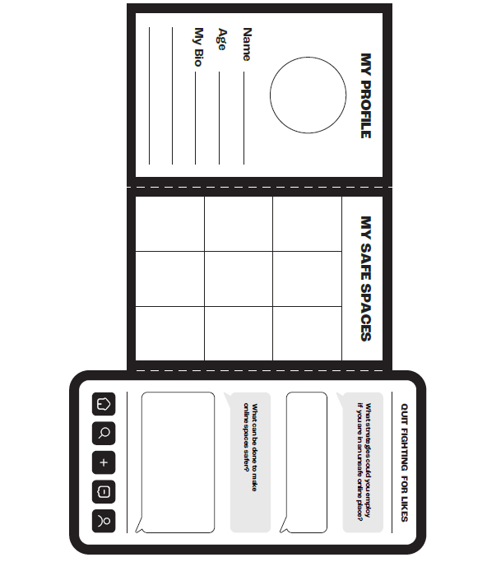
PEER EDUCATION
Safe Spaces
Complete your phones and consider spaces that feel safe and those that could be unsafe.
Fold along the dotted lines to conceal your answers.

Slide 28
Last Person Standing

Slide 29

Notes:
Click enable content to play the video or access it on YouTube: https://youtu.be/Uk3gS0Ya0pY?feature=shared

Slide 30

PEER EDUCATION
You have 2 minutes to write down as many ways as they can think of to take control of their social media.
You can include other ways not shown in the video.

Slide 31
Meme Maker

Slide 32
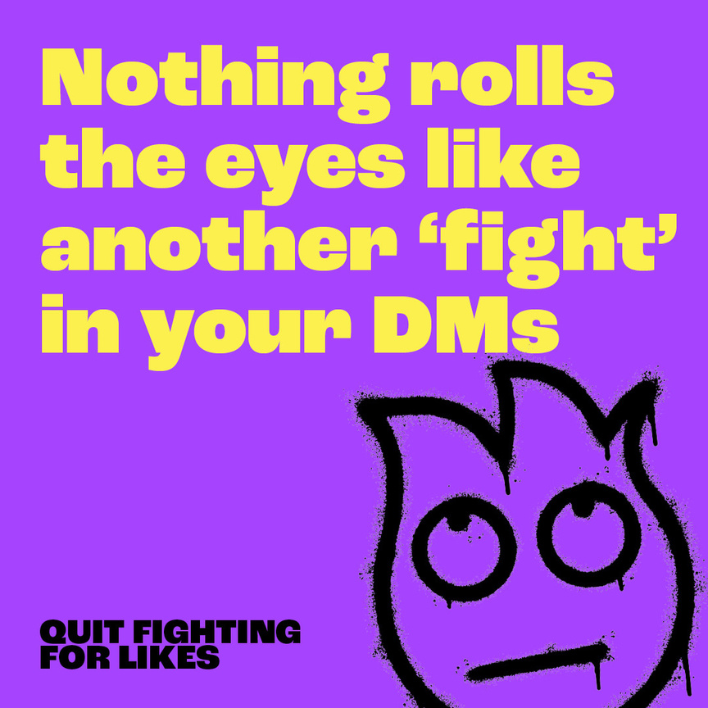
PEER EDUCATION
Meme Maker
  What is a meme?
  What makes the memes effective at discouraging harmful online behaviour?
  Which messages do you find most effective?

Slide 33
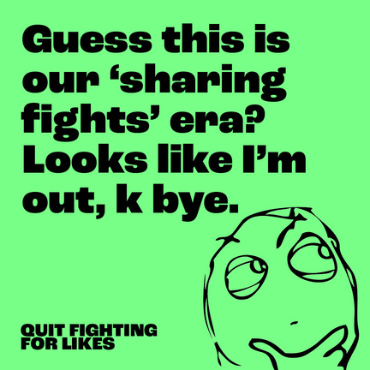

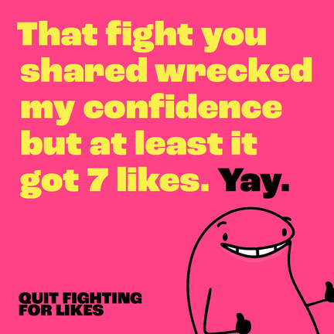
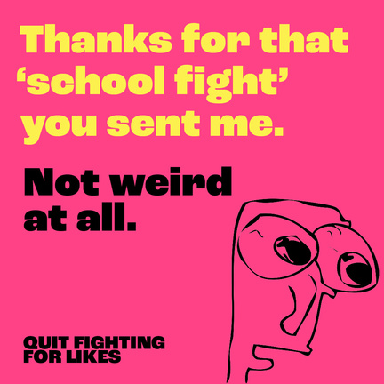
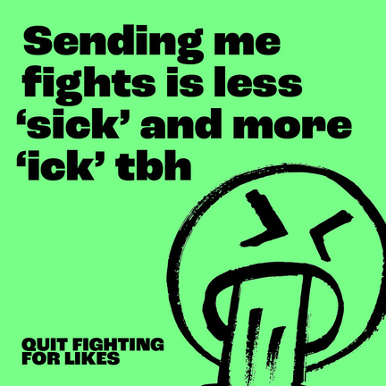
PEER EDUCATION
Examples

Slide 34
Discussion

Slide 35
STEPS to Being an Active Bystander Online

Slide 36
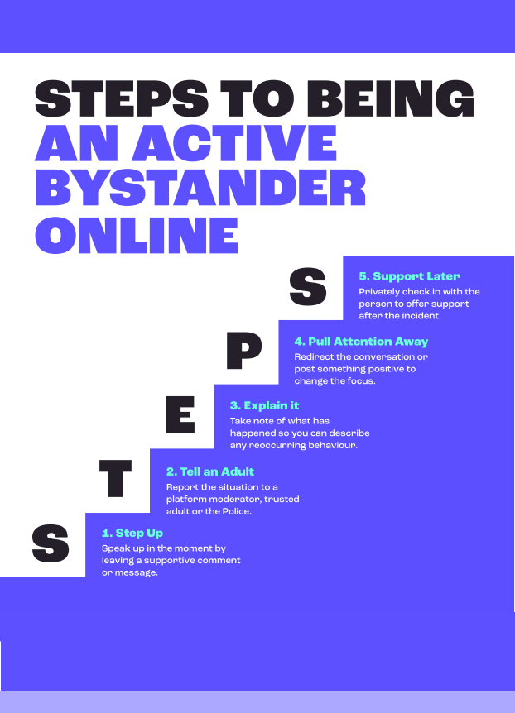

Slide 37
PEER EDUCATION
STEPS to Being an Active Bystander Online
1... Step Up
What impact can leaving a supportive comment have on someone experiencing harmful behavior online? Why might this be effective?
2...Tell an Adult
When should you report online issues to a trusted adult or police? What might stop someone from doing it?

Slide 38
PEER EDUCATION
STEPS to Being an Active Bystander Online
3...Explain It
How can keeping a record of harmful online behavior help in addressing recurring issues? What details should you note down?
4...Pull Attention Away
How can redirecting a conversation or posting something positive defuse a harmful situation online? What are some examples of how to do this effectively?

Slide 39
PEER EDUCATION
STEPS to Being an Active Bystander Online
5... Support Later
Why is it important to check in privately with a friend after an incident? How can this follow-up support their mental health?

Slide 40
The Impact of Social Media

Slide 41
PEER EDUCATION
The Impact of Social Media
You are going to hear a series of statements, you must decide whether you agree or disagree and move to that side of the room.
Agree
Disagree

Slide 42
PEER EDUCATION
The Impact of Social Media
1... My behaviour/actions have been influenced by social media.
Agree
Disagree

Slide 43
PEER EDUCATION
The Impact of Social Media
2...My opinions/views have been influenced by social media.
Agree
Disagree

Slide 44
PEER EDUCATION
The Impact of Social Media
3...My perceptions/thoughts have been influenced by social media.
Agree
Disagree

Slide 45
PEER EDUCATION
The Impact of Social Media
4...I can recognise negative influences on social media.
Agree
Disagree

Slide 46
PEER EDUCATION
The Impact of Social Media
5...I am in control of the way I use social media.
Agree
Disagree

Slide 47
Influenced

Slide 48
PEER EDUCATION
Influenced
Have a think about recenet posts or ads you’ve seen online...

Slide 49
PEER EDUCATION
Influenced
1... Who is trying to influence you?
2...What is their motivation? Why do they want to change your mind/behaviour?
3...How does it make you feel?

Slide 50
PEER EDUCATION
Influenced
4...How do the social media platforms shape the advertisements you see?
5...Have you ever been influenced by social media in a way that led to conflict or violence?
6...How could you avoid negative influences on social media?

Slide 51
Check Out

Slide 52
PEER EDUCATION
Check Out:
Example Questions:
  What are two things you learned?
  What is the most interesting thing you’ve learned?
  Think of one thing you have learned in the session that you can apply to another part of your life. What is it, and how can you apply it?
  What was your favorite activity in the session? Why?
  What was your least favorite activity in session? Why?
  How does something you learned connect to what you already knew?

