Slide 1


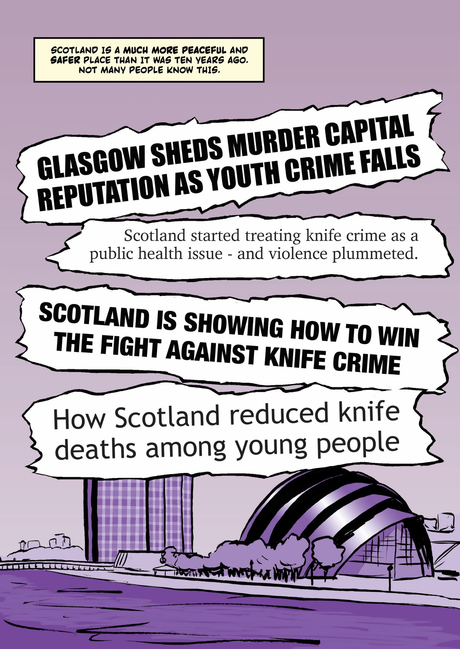


Knife Crime
[Your Names]

Slide 2



What do you already know?
Stand up
Sit down
True
False

Slide 3
Stand Up, Sit Down
1. Glasgow is the ‘murder capital of Europe’​.
2. It’s mostly teenagers who get caught carrying knives​.
3. Boys rather than girls are more likely to be the victims of knife crime​.
4. People carry knives for their own protection​.
5. Scaring people is the best way to stop them from carrying knives.

Slide 4
Why is this topic important?
  Raising awareness
  Myth Busting
  Prevention
  Empowerment
  Starting the conversation

Slide 5
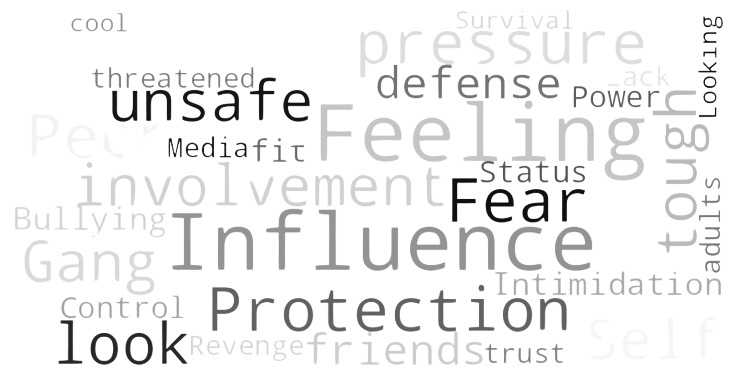
Why do young people carry knives?

Slide 6
Consequences
Legal:
  Arrest and criminal record
  Serve time
  Fines or community service
  Travel restrictions
  Future job prospects

Slide 7
Consequences
Social:
  Impact on education
  Loss of trust from friends and family
  Stigma and reputation
  Increase risk of violence
  Fear and isolation

Slide 8
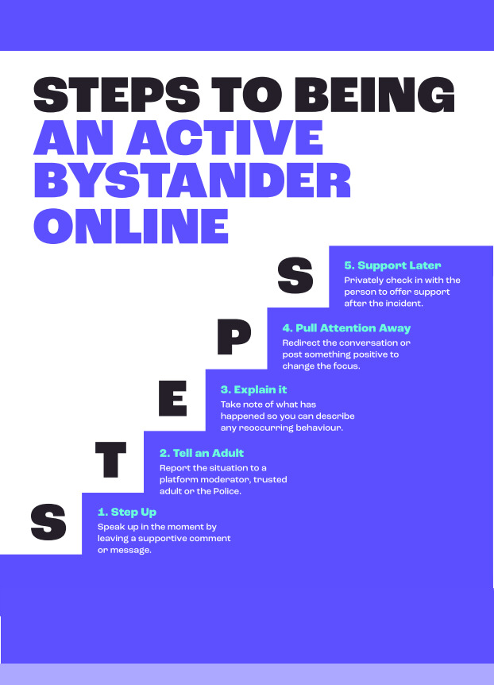
How to help a friend

Slide 9




Support

Slide 10


Any questions?

